Slide 1
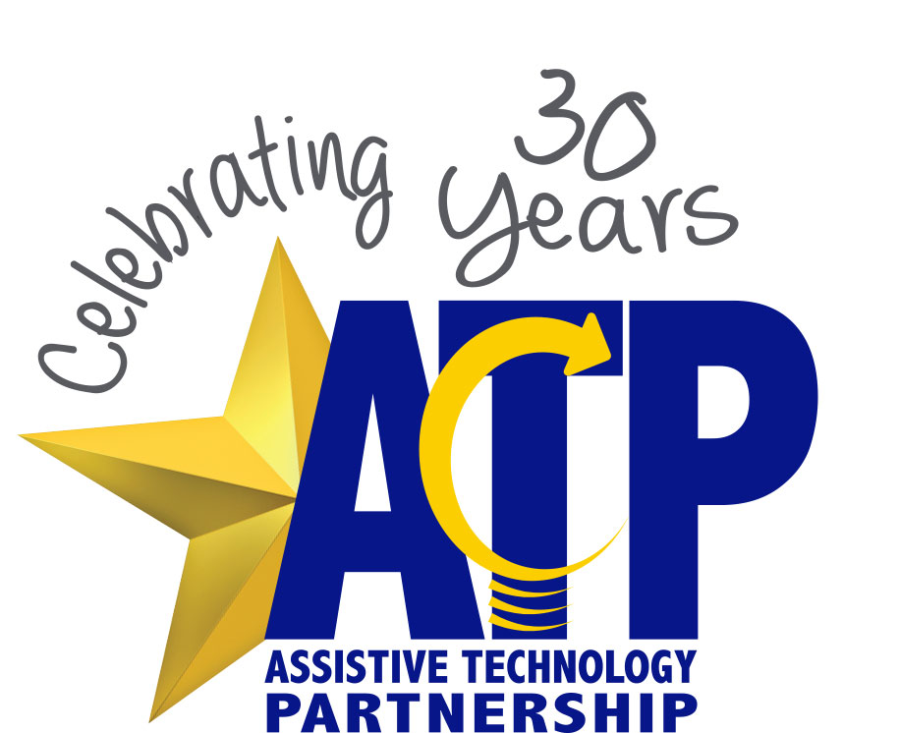
Celebrating Our Partnership
- Established 1989 -

Slide 2
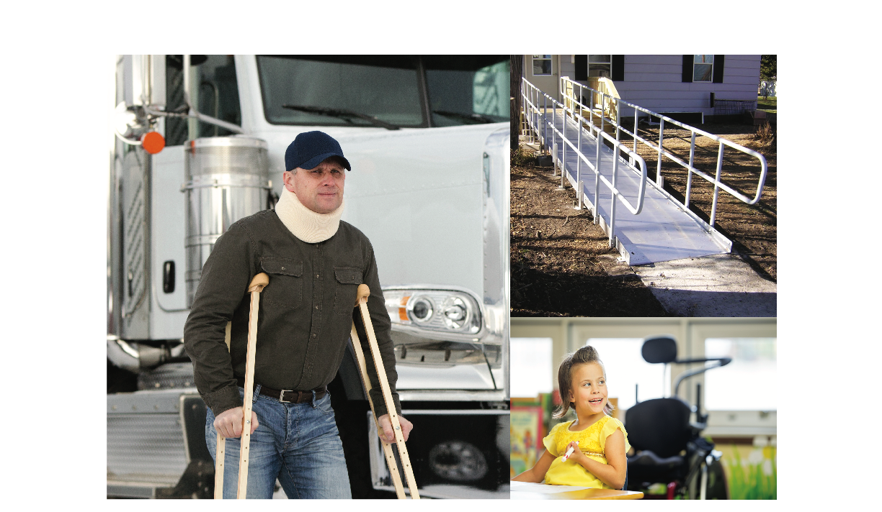
1989
Nebraska VR applied for a grant to establish the Assistive Technology Project (ATP). Nebraska was one of the first nine states to be awarded funding from the Technology-Related Assistance Act of 1988.

Slide 3
1998
ATP’s name changed from Project to Partnership to represent the unique collaboration that began and continues today with Nebraska VR, Nebraska Health and Human Services, Nebraska Department of Education, and others.

Slide 4
The Partnership makes independent living possible at home, school, and work by helping Nebraskans access and use equipment and modifications through a single point of entry.

Slide 5
“The outcome of the Partnership is the availability of assistive technology services to individuals of all ages and disabilities. Much credit needs to be given to the state agencies and organizations who had the vision and courage to change the status quo in an effort to provide better services to persons with disabilities in Nebraska.”
- Mark Schultz, Former ATP Director

Slide 6
Technology with a Purpose
ATP’s seamless services across programs has a resulted in less duplication and made it possible for individuals with disabilities, professionals, employers, and educators to:
connect with experienced staff to assess what is needed;
identify the best solution available;
experiment before purchase with an equipment loan;
learn from training;
research funding possibilities;
and access used equipment.

Slide 7
HHS Partnership

Slide 8
HHS Partnership
Partnership with Medicaid and Long-Term Care and Division of Developmental Disabilities
All assistance through HHS services starts with a referral
ATP cannot duplicate services offered through a consumer’s Medicaid Managed Care plan
ATP follows the regulations for each program and must overall comply with the Medicaid regulations when looking at modifications that involve medical devices
ATP provides an independent functional assessment of the consumer’s needs and makes recommendations based on what is observed and demonstrated by the consumer.
Examples of some types of projects include; entrance modifications, vehicle modifications, and bathroom modifications

Slide 9
Funding Coordination

Slide 10
Funding Coordination
Funding for the cost of home modifications, assistive technology, or services needed by consumers who experience a disability are not directly funded by ATP. Funding may be available from numerous programs. Examples include disability-related organizations, government programs, and non-profits, etc.
Each resource has their own eligibility requirements. Requirements may include age, residence, disability, income, request, etc. Funding amounts also vary and it may require several resources to fund what is needed.

Slide 11
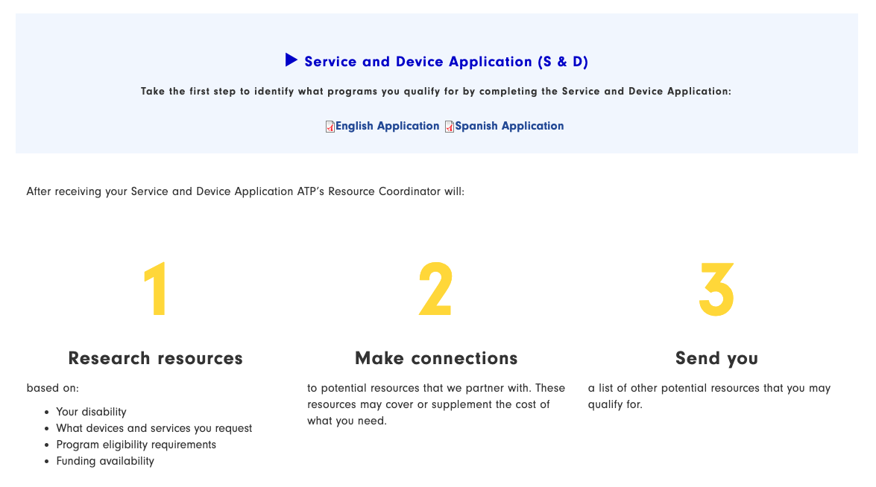
Service and Device Application
Completing the Service and Device (S&D) application begins the process of coordinating the funding options for assistive technology.
You can locate the S&D is located on ATP’s website at www.atp.nebraska.gov under the funding tab.
The S&D is multi-agency form that can be forwarded to agencies for further coordination of services.
Both English and Spanish versions of the S&D are available

Slide 12
What happens when you submit a S&D for funding coordination?
It will be reviewed for key agency or program referrals, ie Medicaid Wavier, Veterans Services, Nebraska VR.
Communication will be made with applicant to gather more information on services requested.
Once all resources are evaluated for eligibility requirements, the applicant will receive a resource letter with names and contact information on possible funding options.
The service request is open for 90 days from time of letter.
This Photo by Unknown Author is licensed under CC BY-SA

Slide 13
Education Partnership

Slide 14
Notes:
Traditionally ATP has functioned through a bit of a ‘Concierge Model’.

Slide 15
Building Capacity for Quality AT Services for Every Chilld/Student Who Needs AT
Notes:
Traditionally ATP has functioned through a bit of a ‘Concierge Model’.

Slide 16
The Education Program within ATP creates capacity for quality AT services for every student/child who needs AT by:
Providing training/coaching related to AT services and AT tools/systems
Engaging in strategic partnerships with key stakeholders and constituencies
Creating access to AT tools/systems for education systems
This Photo by Unknown Author is licensed under CC BY-NC
Notes:
We provide trainings to those working most closely with children/students who need AT
We

Slide 17
Vocational Rehabilitation Partnership

Slide 18
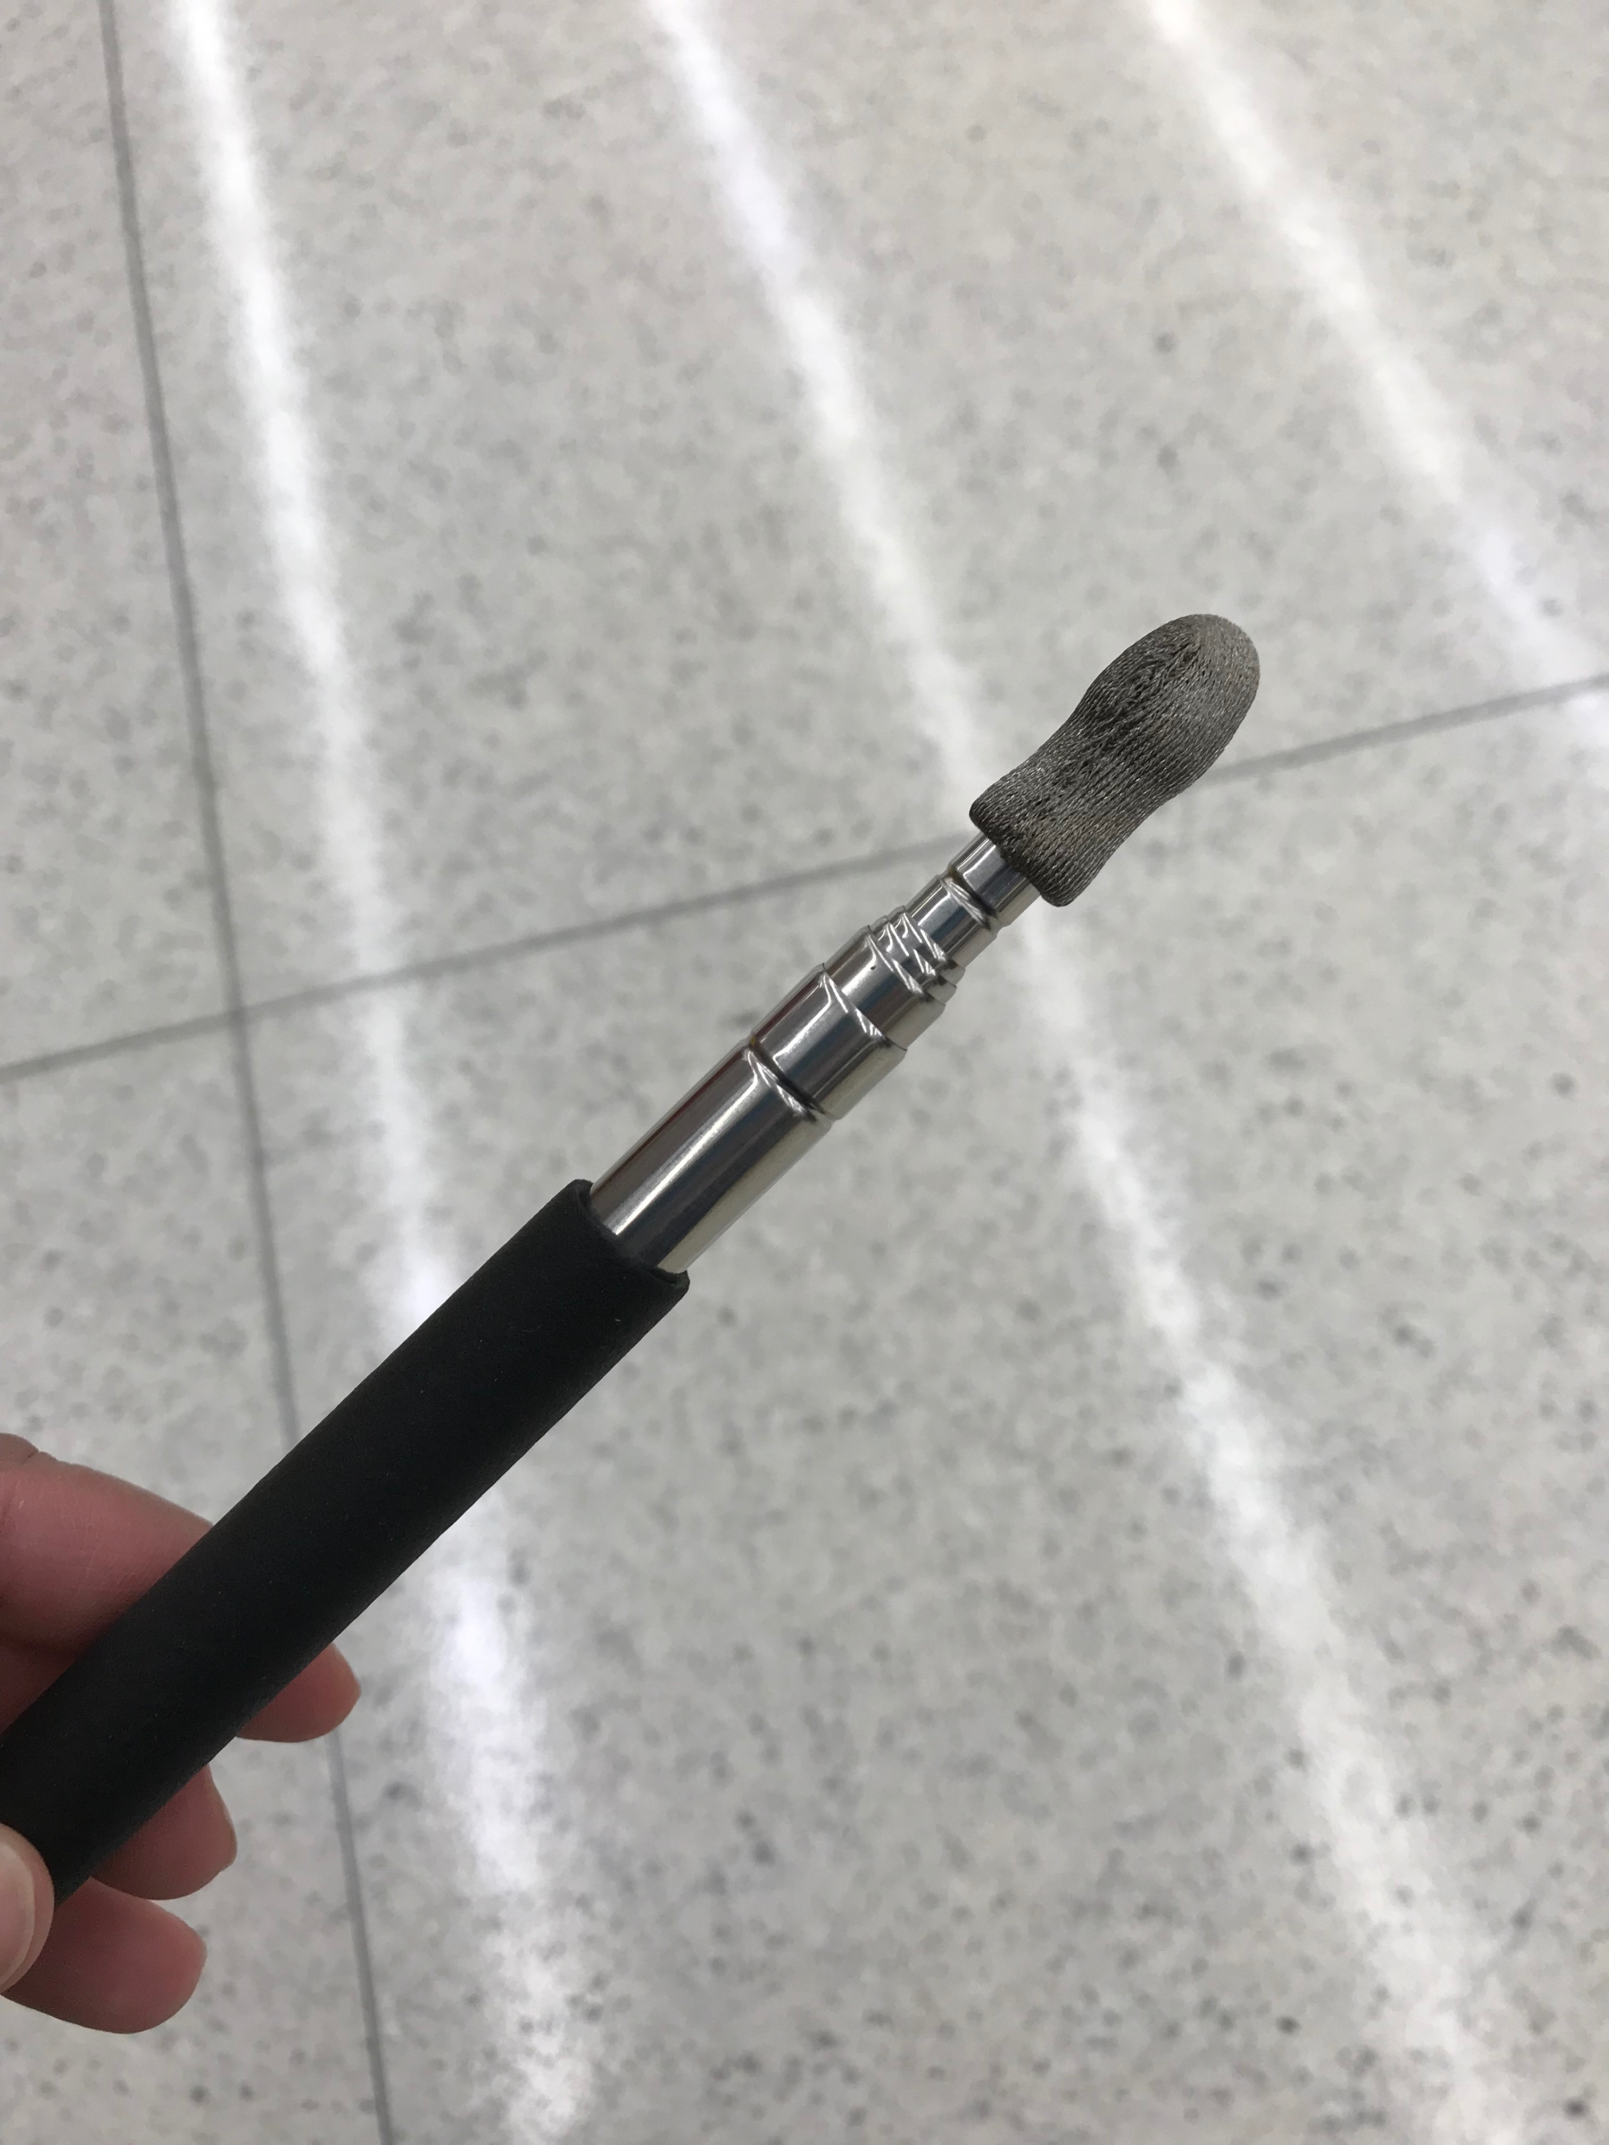
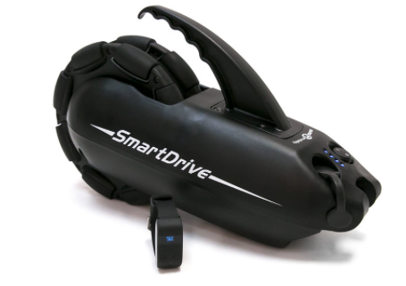
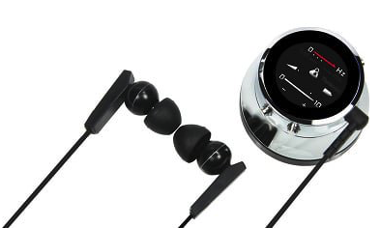
Nebraska VR Partnership
Technology Specialists receive a referral from Nebraska VR and meet with the client at their home, work, school, etc. for the assessment and make technology recommendations for the most cost-effective solution that would assist them with getting or keeping a job and/or being successful in school/training.
Home modifications
Vehicle modifications
Ergonomic Assessments
Cognitive Aids
Hearing/vision devices
ADL equipment/ mobility devices
Worksite AT

Slide 19
Nebraska VR/ATP Success Story
Christian is a student working with Nebraska VR through Pre-Employment Transition Services. He was in need of a new manual wheelchair to use at home and transport himself to and from school. He has a power wheelchair at school, but it can not fit in his home. The old manual wheelchair he was using was in poor condition and was a safety concern as it no longer had anti-tippers on the back and other important features. Insurance would not help with a new manual wheelchair as they purchased the new power wheelchair, so the family completed a Service and Device Application through ATP. They were eligible for the Enrichment Foundation Grant since they live in Sarpy county and Christian was able to get a new manual wheelchair. He also needed a grabber as he has difficulty reaching items higher up from his wheelchair. There was a grabber available on the AT4ALL website through the Reuse Program he was given for free.

Slide 20
AT4ALL

Slide 21
AT4ALL.com
Demonstration and short-term loans
Used equipment for sale
Free donated items
List items to sell or donate

Slide 22
ReUSE Program

Slide 23
ReUse Network
Reuse is the term used to refer to recycled, reused, or repaired durable medical equipment (DME), adapted devices, or assistive technology.

Slide 24
ReUse Partners
Independence Rising
Nebraska Agrability
LoHD
Aging Parners
Chrissy’s Closet
Lincoln E.D. Connections
Catholic Social Services
Blue Rivers Area Agency on Aging
ALS in the Heartland
HELP Adult Services
Mobility Equipment Restoration
Muscular Dystrophy Assoc.
Nanopac

Slide 25
Success Story
ATP’s Reuse Program Coordinator was contacted by a staff person from Habitat from Humanity. Outside one of the homes the organization was demolishing was a vertical platform lift that had been left behind. Local vendors did not request it's return, and approved using it for another project. Weeks later ATP was contacted by the mother of a young veteran receiving medical care at a local Rehabilitation Hospital in another town an hours drive away. The discharge plan was for the veteran to return home to live in his parent's house and the family was working with the VA to identify permanent entrance modifications. Plans included a ramp in the front of the house but this was going to take time. As the holiday season was approaching, the mother had her own goals to bring her son home. The veteran's doctors would not release him from the hospital until there were two safe exits from the home.
A 12 foot ramp was loaned to the family for the front entrance while they awaited VA funding for a permanent ramp installation. The Program Coordinator connected the mother with the staff at Habitat for Humanity to discuss the exchange of the vertical lift. With the help of handy friends of the family, the lift was installed in the garage entrance to the home. The veteran was able to return home for the holidays, remain home, and continue outpatient rehabilitation at a local hospital.

